Slide 1

Project Overview: Linking and Analyzing Data on Deaths in US Prison
Project Manager: Abdul Wasay
Team Members: Sam Grossman, Johnathan Ross, Ramil Mammadov

Slide 2
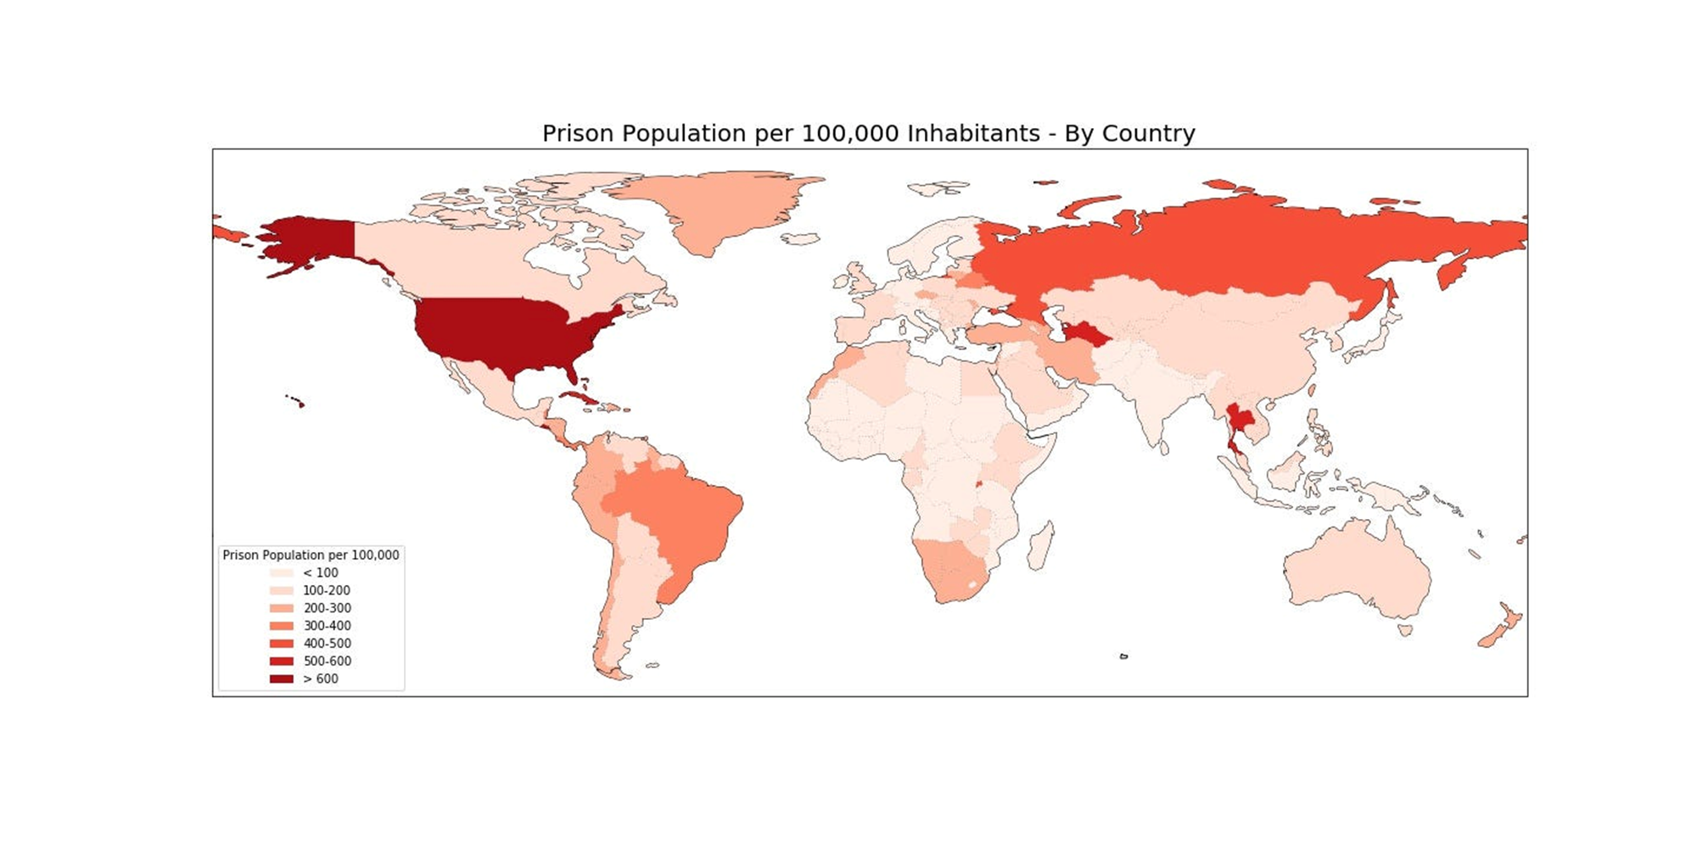
•The US currently has between 1.9 – 2.1 million prisoners
•The US ranks 5th in prisoners per capita

Slide 3
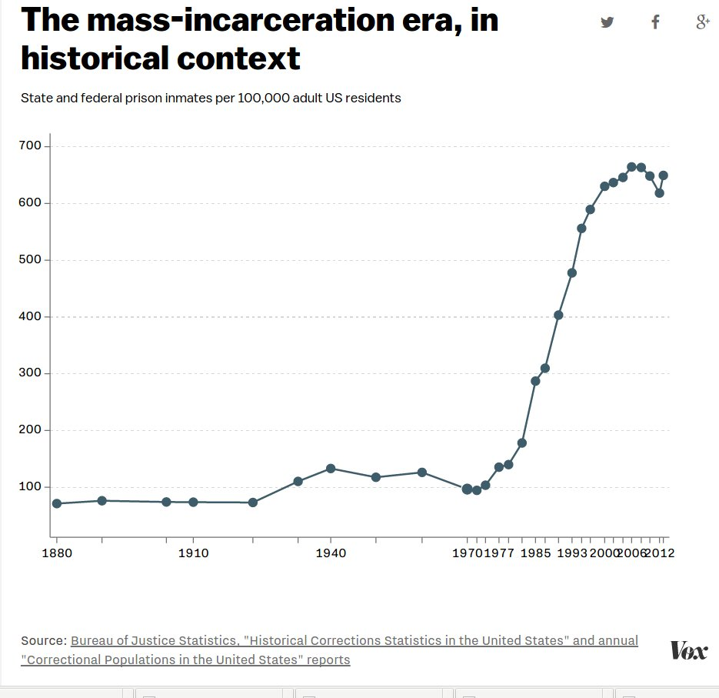
How We Got Here
Only 200,000 US prisoners in 1970 compared to around 2 million today.
1970’s: War on drugs, “Tough on Crime” policies.
1980’s and 1990’s: Mandatory minimum sentencing, Three strikes Laws, Harsher restrictions on parole.
32% of the US prison population is Black, 68% of the prison population is from a minority group.

Slide 4
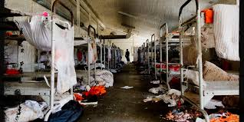
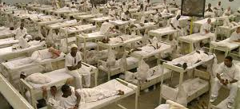
The Prison System Itself
Issues in the US Prison System include:
Overcrowding
Health concerns and limited to no access to healthcare
Physical and mental abuses
Post-release problems
And more

Slide 5
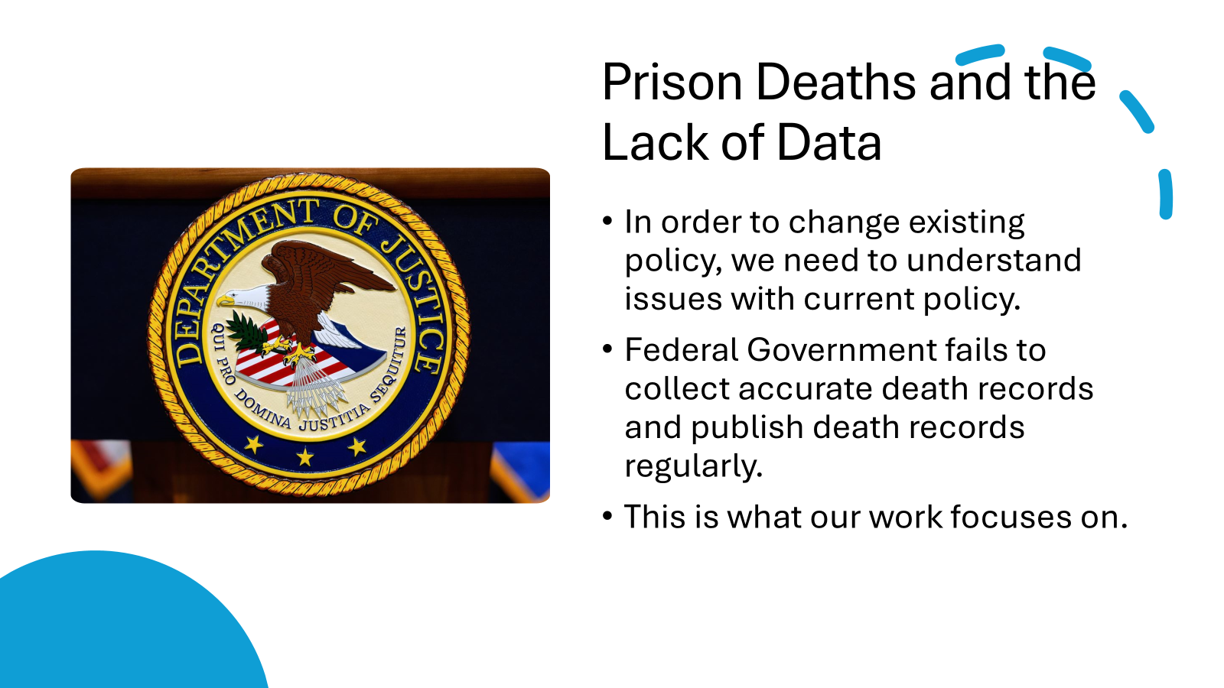

Slide 6

Third City Project
Our project is part of Third City Project’s research
“The Third City Project promotes data transparency for the complete physical, mental, and social well-being of individuals and communities impacted by the criminal legal system, shining light on data behind its walls.”

Slide 7


Data Collection
We contribute to existing Third City Project datasets on prison deaths.
Our team manually reviews public records and press releases from state Departments of Corrections.
Data is entered into Qualtrics using a structured form to ensure consistency.

Slide 8

Data Sources
Primary Source • State Department of Corrections press releases • Manually reviewed and entered into Qualtrics • Includes name, date, location, cause (if listed)
Secondary Source • Bureau of Justice Assistance (BJA) dataset • Used to cross-check for missing or mismatched records • Helps validate and supplement manual entries

Slide 9
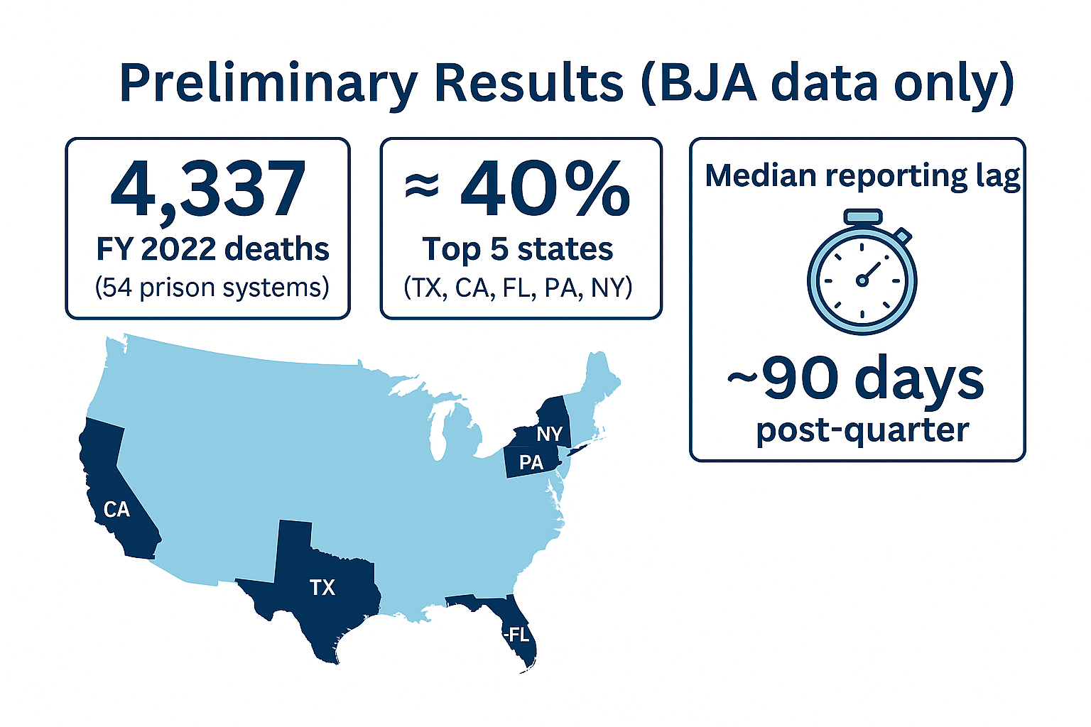
Any preliminary results?
4,337 FY 2022 deaths (54 prison systems)
≈ 40 % of deaths in TX, CA, FL, PA, NY
Median reporting lag: ~ 90 days after each quarter

Slide 10

Examples of Research questions:
R1: What share of deaths in the BJA file appear in state press releases?
R2: How often does a press-release cause match the vital-records cause?
R3: Which states release death notices within 30 days, and which take longer?
R4: Are certain age groups or races more likely to have missing or delayed records?
R5: Do privately run prisons differ from state-run prisons in reporting speed or accuracy?
R6: Can unsupervised clustering reveal hidden patterns (Exp, facilities with similar profiles of overdose, violence, or medical deaths)?

Slide 11

Analysis Plan
• Statistical or ML approach (e.g., Python/R EDA, clustering, regression).
• Data-cleaning and validation steps.
• Planned visualizations or dashboards.
• Any software, packages, or reproducibility notes.

Slide 12

What’s “Cool” about the Project?
Live check: to match press releases with federal counts
Instant alerts: dashboards flag overdose spikes fast
Policy fuel: linked data pushes for quicker, fuller reporting

Slide 13

Purpose of the Project
Close data gaps: matching federal records with state press releases for difference
One trusted source: merging datasets and creating public dashboard
Drive reform: reveling serious problems and giving information for policymakers

Slide 14

Challenges & Barriers
Missing notices: Some states post very few death notices or none at all
Confusing formats: Different terms are used for the same cause of death
Slow reporting: Late records delay confirming the cause of death
Limited resources: Too little staff, money, and time leads to more errors

Slide 15


Next Steps & Call-to-Action
Finish linkage between federal records and state press releases
Make EDA, use models and create interactive dashboards
Write policy memo with findings and reform ideas

Slide 16
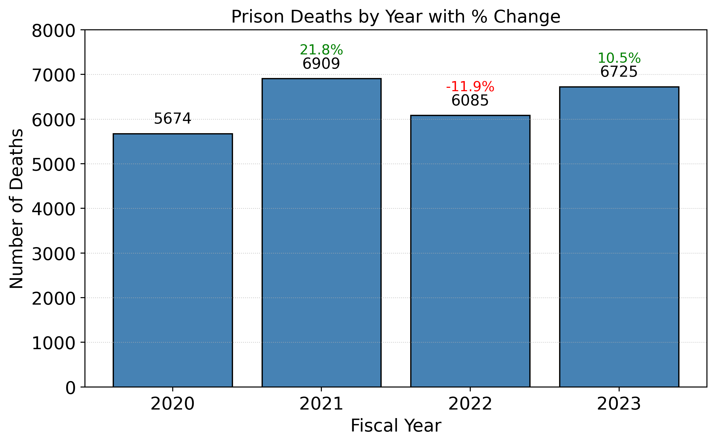
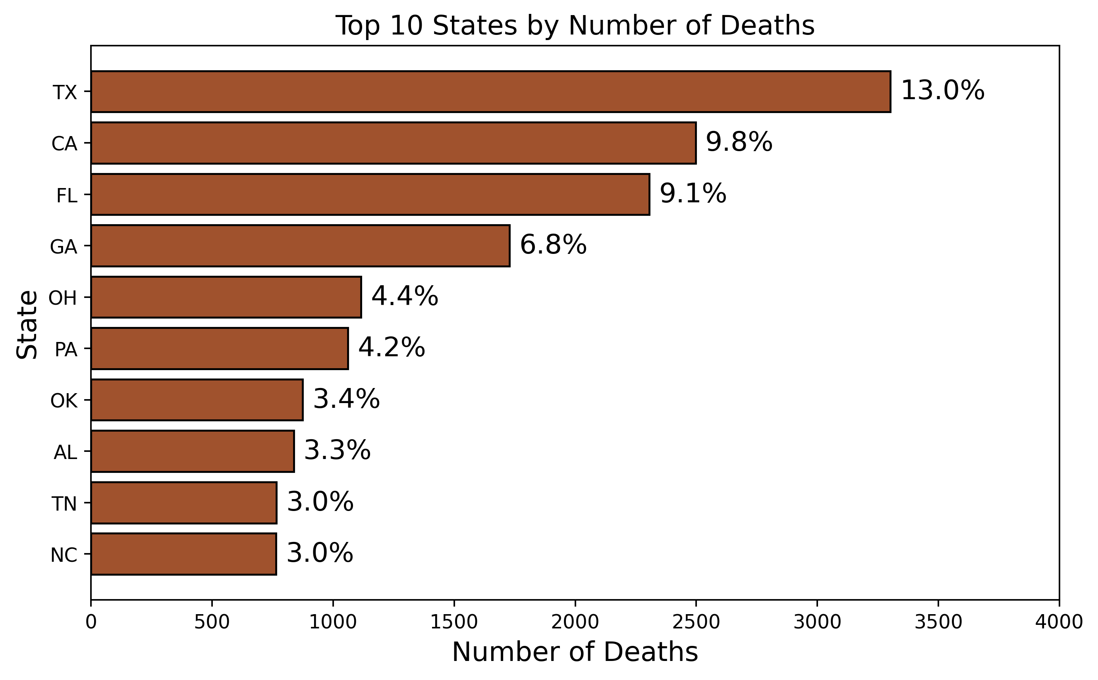
State Hotspots & Year-to-Year Swings (2020-23)
Year-to-year swings: deaths +22 % in 2021, −12 % in 2022, then +10 % in 2023. Net result - about 6.7 k deaths in 2023, up 18 % vs 2020.
Deaths cluster in a few states - Texas tops the list (≈3.3 k / 13%), and the ten highest-count states make up 50 %+ of all prison deaths.

Slide 17
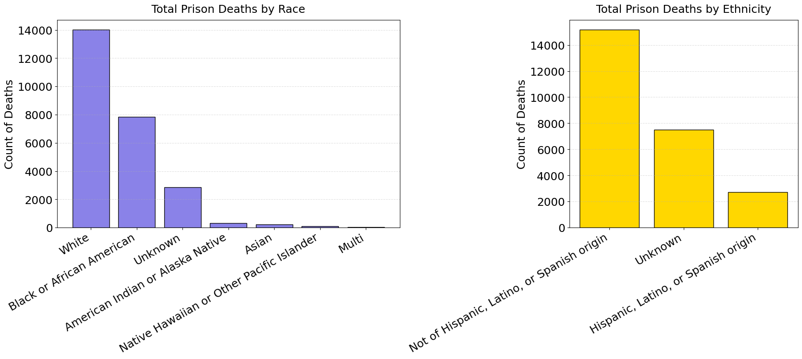
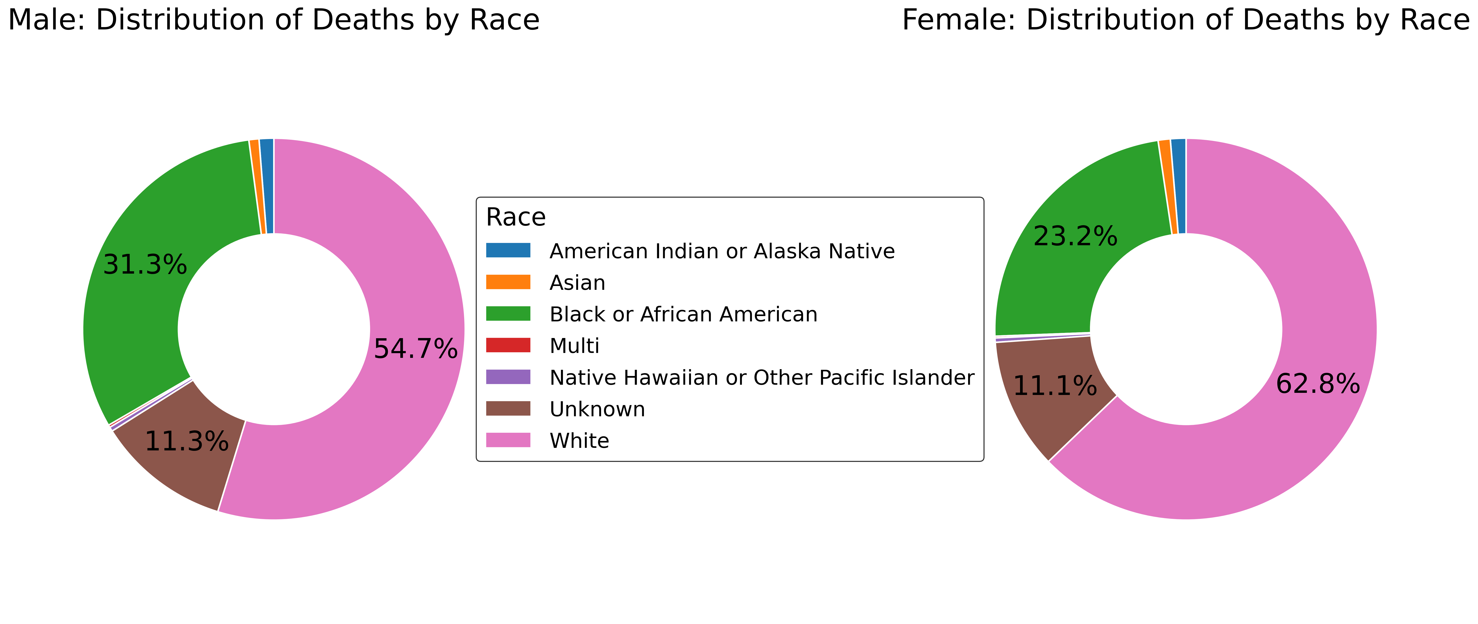
Race & Sex Disparities in Prison Deaths (2020-23)
Deaths are highly concentrated among White prisoners (≈14 k) followed by Black/African-American (≈8 k); other races are an order of magnitude lower.
Sex split shows the same ranking but different weights: among males the share is 55 % White / 31 % Black, while among females it skews even more White (63 %) with a smaller Black share (23 %).

Slide 18
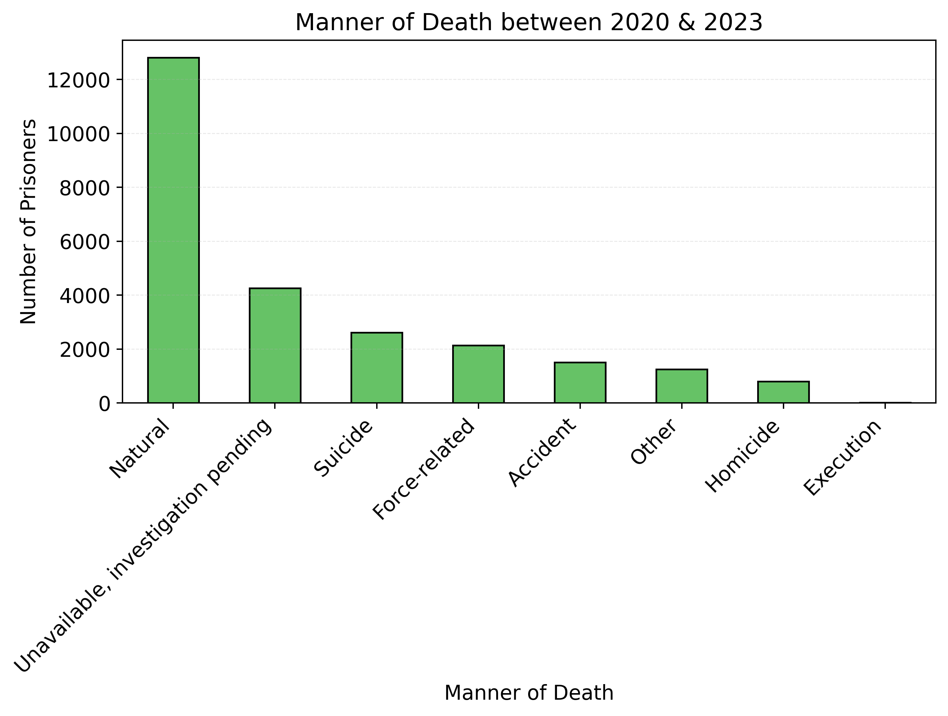
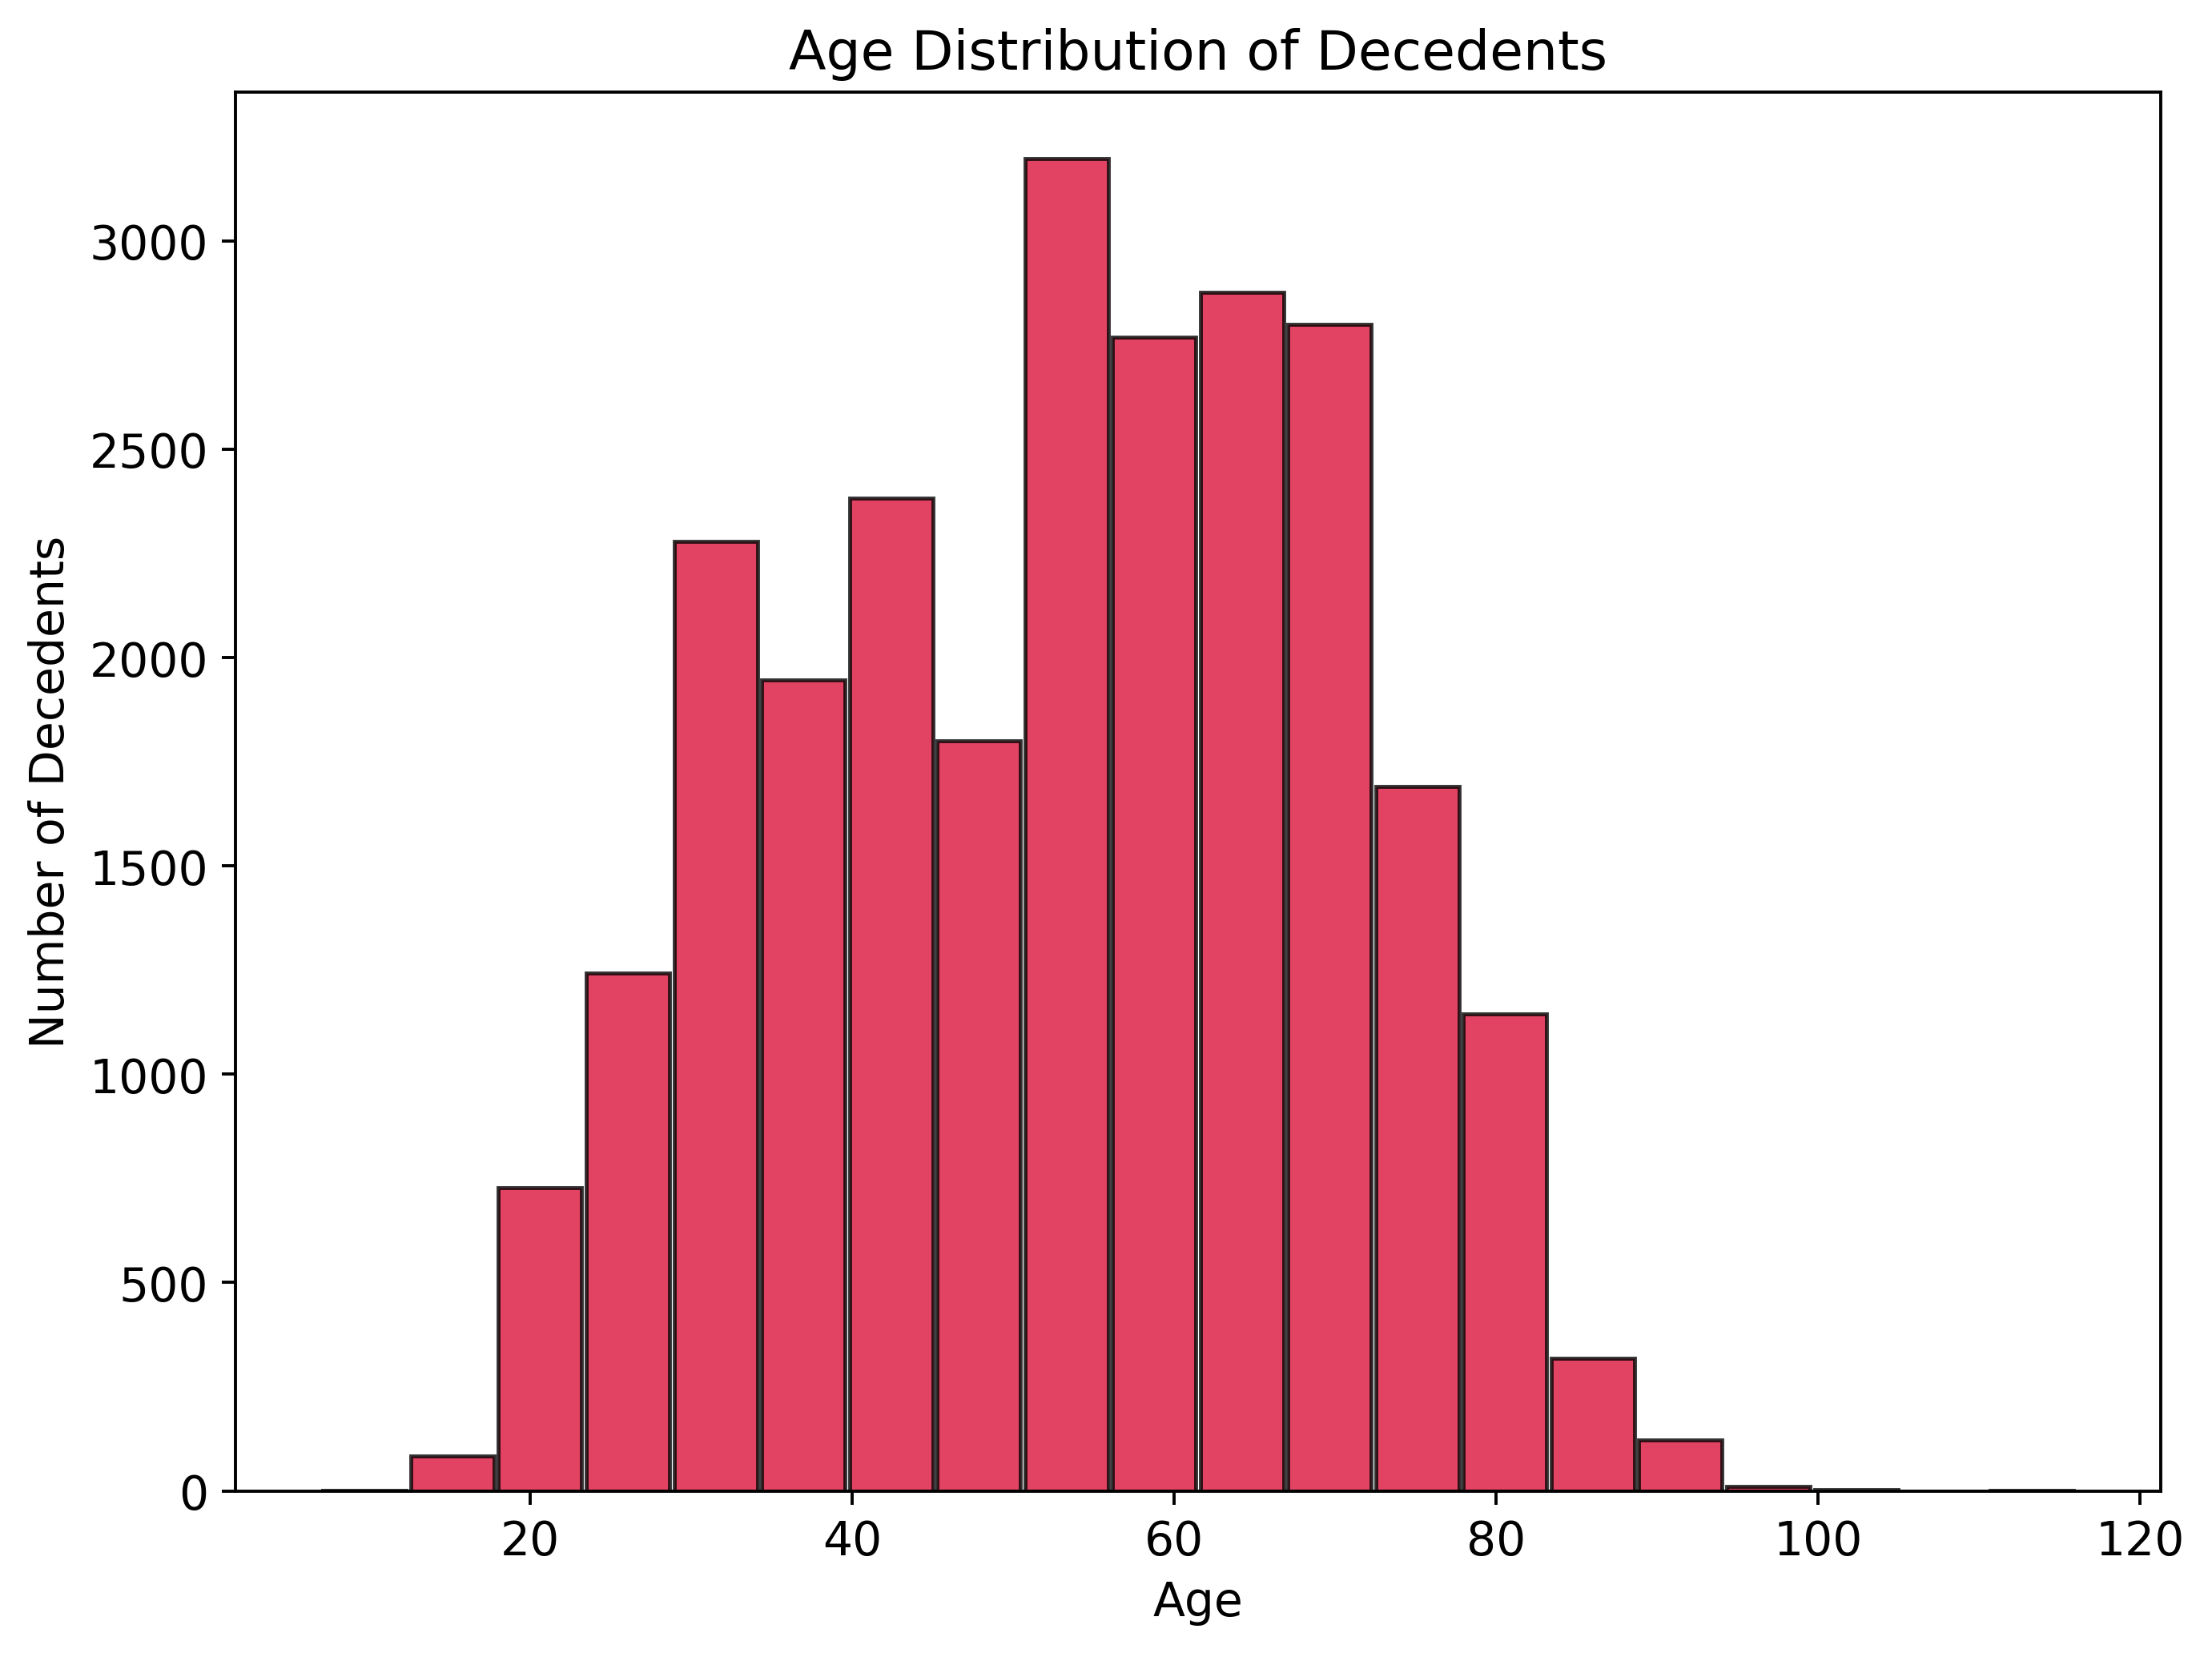
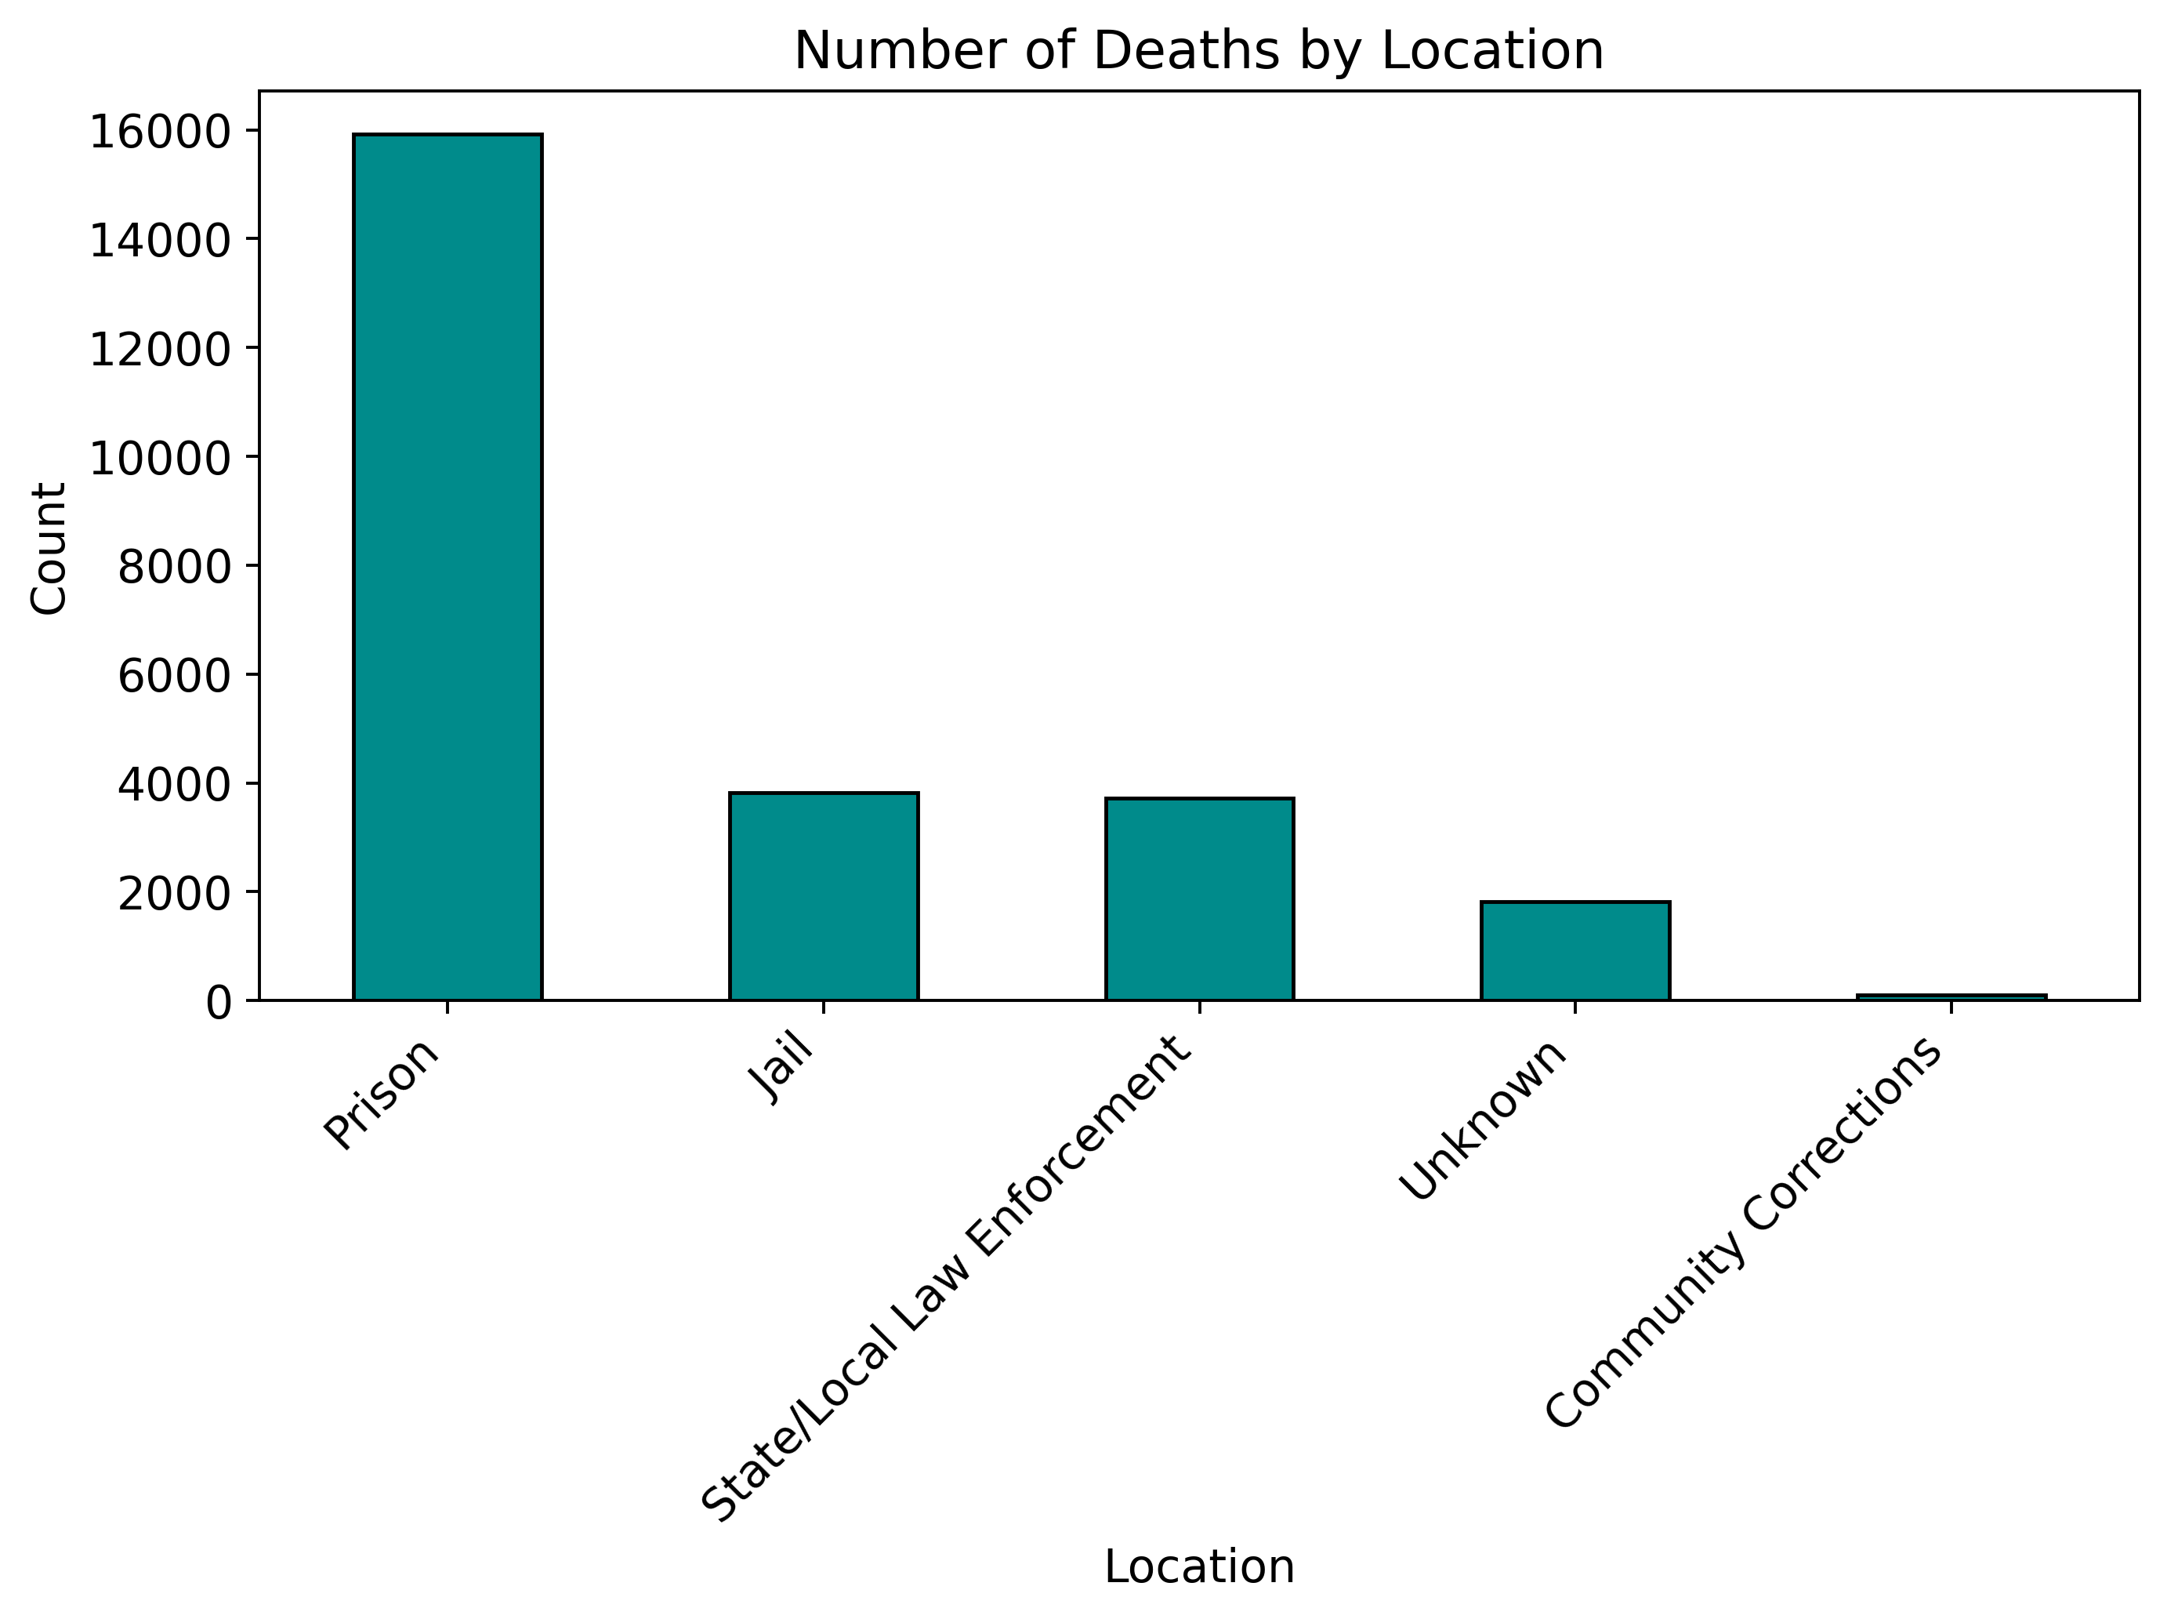
Prison Mortality Snapshot (2020-23)
Natural causes dominate (≈13 k). Pending investigations, suicide and force-related cases make up the next tier; executions and homicides are rare.
Most decedents were 40-70 yrs; deaths peak in the late-50s / early-60s and drop sharply after 80.
Overwhelmingly in state prisons (≈16 k). Jail and state/local law-enforcement facilities each add ≈3-4 k, while community-corrections deaths are negligible.

Slide 19

Thank you — questions?

